Slide 1
Data-Driven Marketing: Uncovering Insights for Campaign Success

Slide 2
Introduction
Both diagnostic and descriptive analysis were perform on the marketing campaign analysis dataset to get detail inspections of Conversion Rate alongside Click Through Rate (CTR) and Cost Per Clicks (CPC) along with Return of Investment (ROI) and Engagement Score measurements.
The primary aim of this analysis is to diagnose the underlying factors driving campaign success and to identify areas where optimization can yield improved outcomes.
To achieve this, we will explore trends over time using time-series analysis, evaluate the customer journey through funnel visualization, and compare performance across different channels and geographic regions.
By uncovering these insights, our objective is to equip decision-makers with actionable strategies to enhance targeting, optimize resource allocation, and ultimately maximize ROI.
2

Slide 3
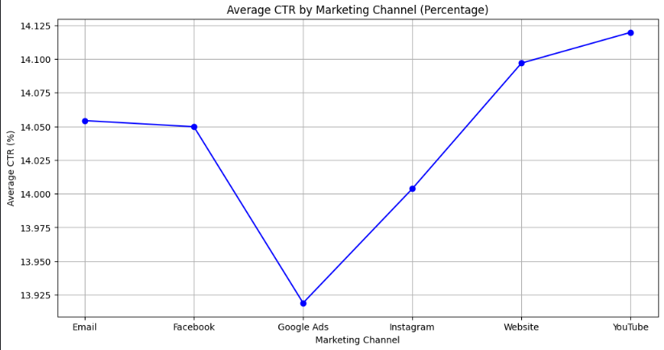
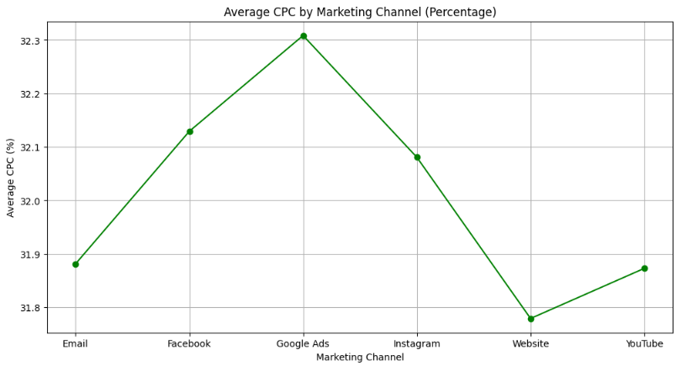
Findings & Insights
The initial user interaction (clicks) and associated costs, no single channel significantly outperforms the others.
3

Slide 4
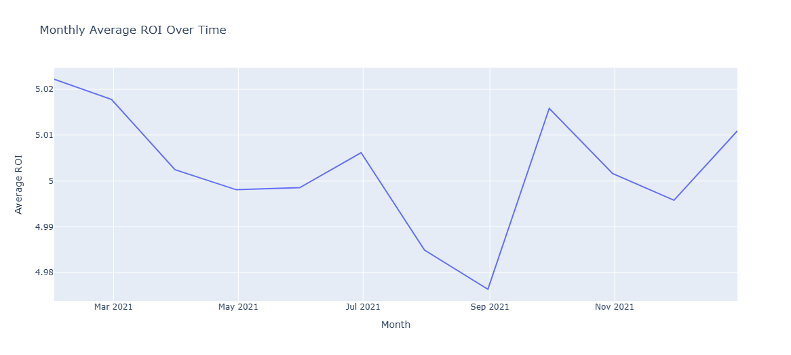
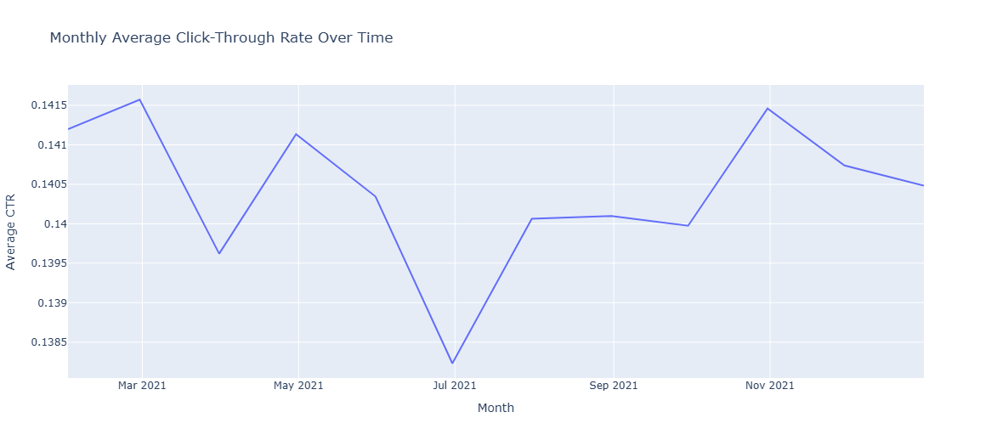
Findings & Insights
4

Slide 5
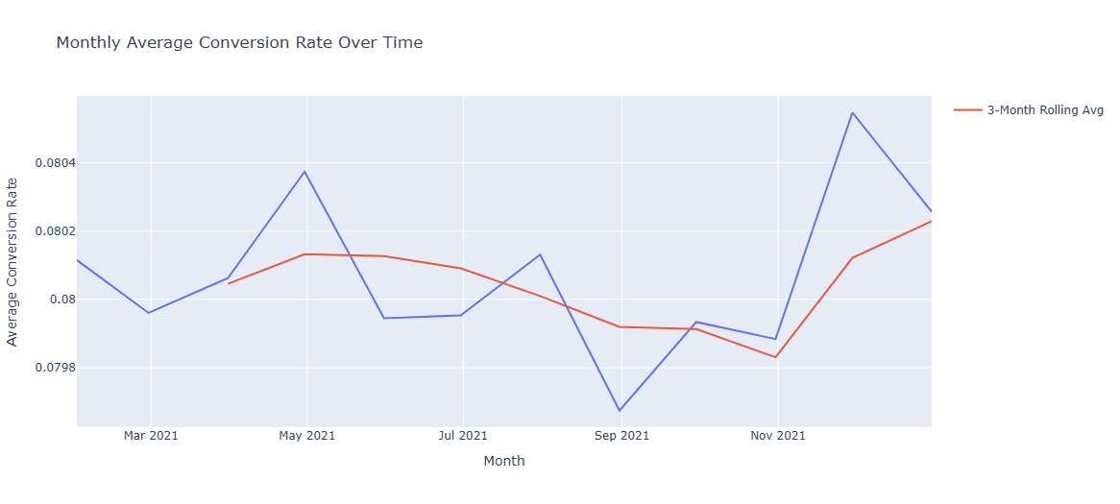
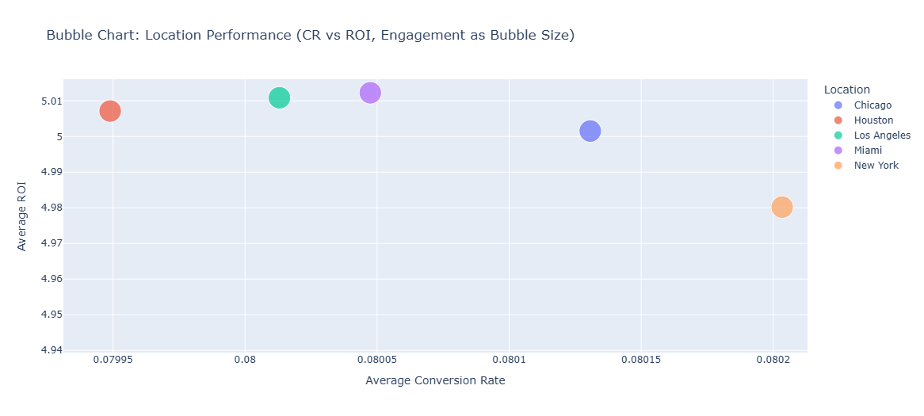
Findings & Insights
5

Slide 6

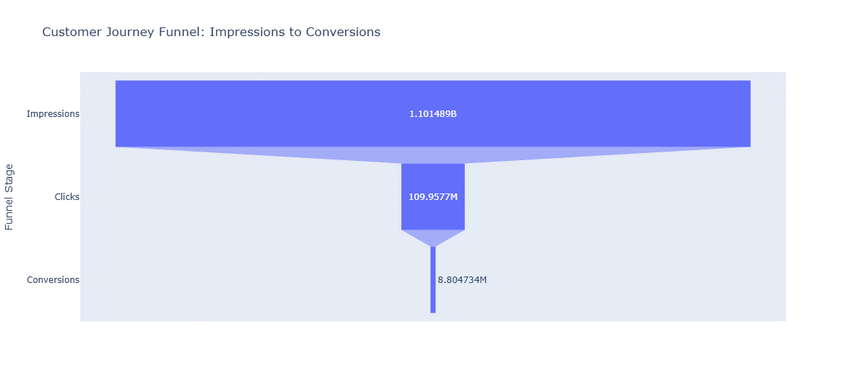
Findings & Insights
6

Slide 7
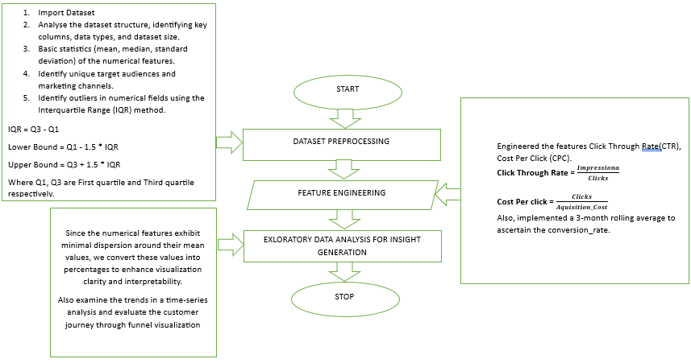
Code & Methodology
7

Slide 8
Recommendations
Actionable Strategies to Optimize Marketing Campaigns
Ad Creative & Messaging: A/B test creatives and headlines by channel.
Post-Click Optimization: Improve landing pages and clear CTAs to boost conversions.
Strategic Timing: Use time-series insights to schedule campaigns during high-performance periods.
Channel Budgeting: Shift budgets to channels with lower CPC and higher ROI.
Audience Segmentation: Personalize campaigns for high-performing customer segments.
Funnel Monitoring: Continuously track funnel metrics to quickly address drop-offs.
Predictive Analytics: Leverage forecasting models to anticipate performance trends.
8

Slide 9
Conclusions and Next Steps
The analysis shows stable conversion rates, CTR, and ROI across channels, with a consistent performance over time.
Funnel analysis highlights notable drop-offs between clicks and conversions, signaling opportunities for enhancing the post-click experience.
Actionable strategies include refining ad creatives, optimizing landing pages, reallocating budgets to high-performing channels, and leveraging time-series insights for strategic campaign timing.
Next Steps:
Enhance Audience Engagement: Analyze Engagement_Score, Clicks, and Customer_Segment data to gain deeper insights into user behavior and tailor messaging accordingly.
Optimize Spending: Compare Acquisition_Cost against Conversion_Rate and ROI to identify cost inefficiencies and improve budget allocation.
Further Analysis:
Conduct deeper segmentation by demographics and geography.
Implement A/B testing for ad creatives and landing pages.
Leverage predictive analytics to forecast performance trends and drive proactive optimizations.
9

